Slide 1
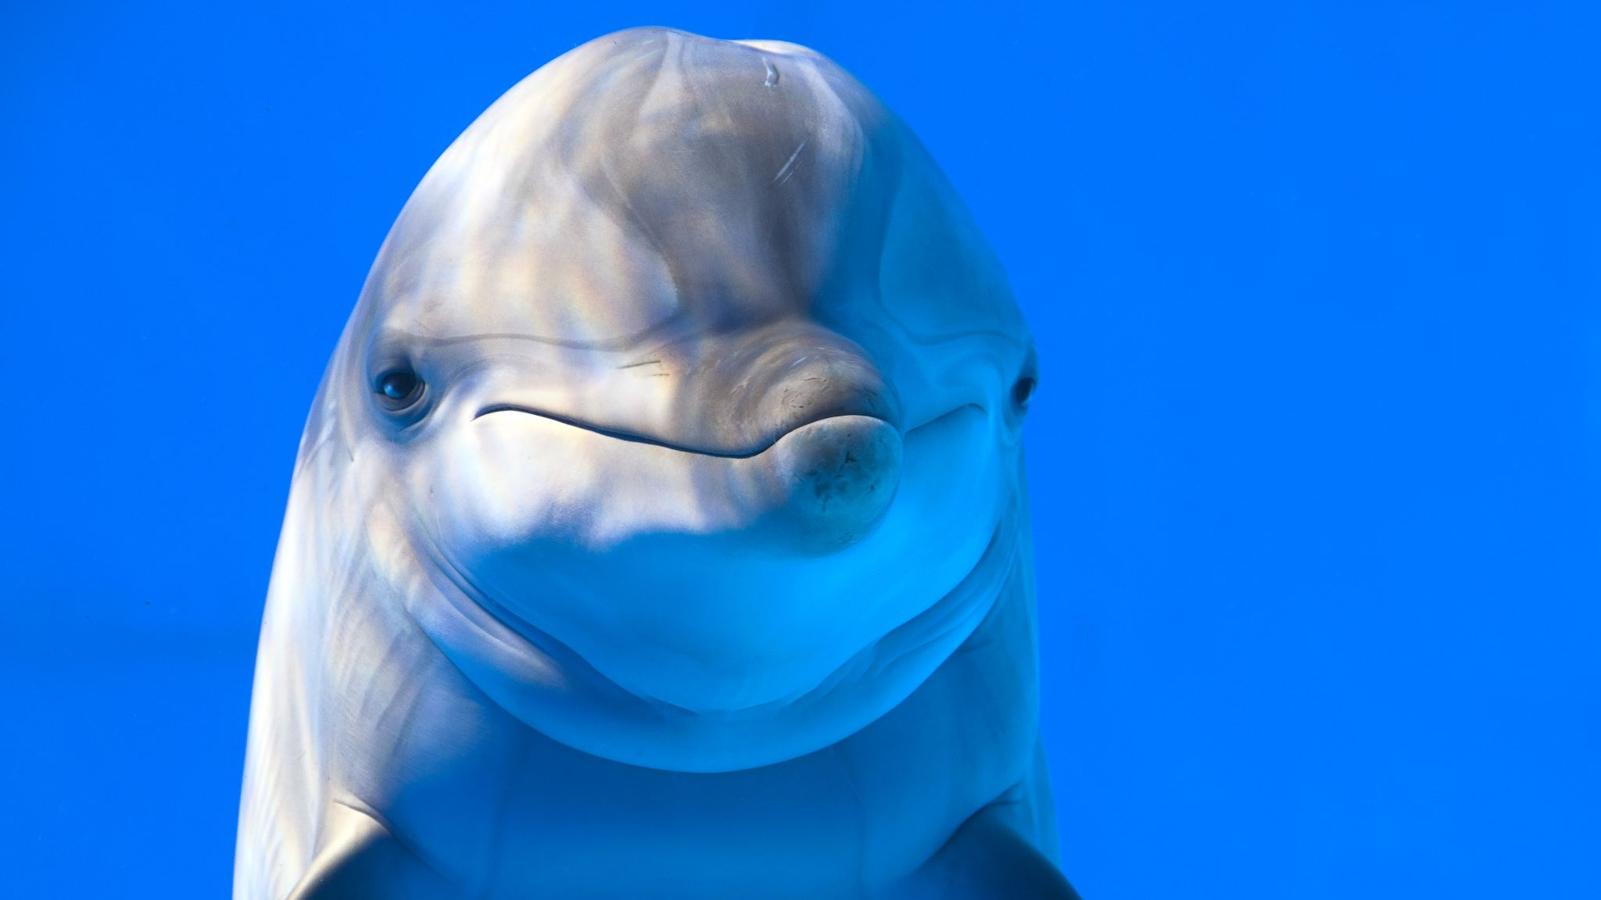
DOLPHIN
---PRESENTED BY PRITY GHOSH
CU ROLL NO : 223144-11-0010
CU REGISTRATION NO:144-1211-0308-22

Slide 2

•SCIENTIFIC CLASSIFICATION
{According to “The life of vertebrate” by J.Z Young,1981}
KINGDOM | Animalia
PHYLUM | Chordata
SUBPHYLUM | Vertebrate
CLASS | Mammalia
ORDER | Cetacea
FAMILY | Delphinidae
GENUS | Delphinus
SPECIES | Delphis
SPECIMEN | Delphinus delphis
COMMON NAME | Short - beaked dolphin

Slide 3
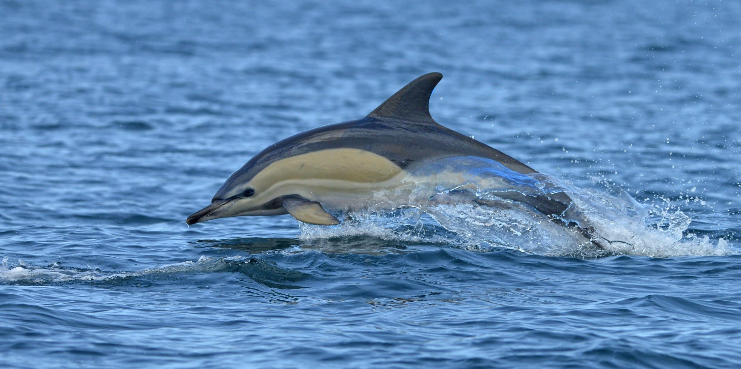
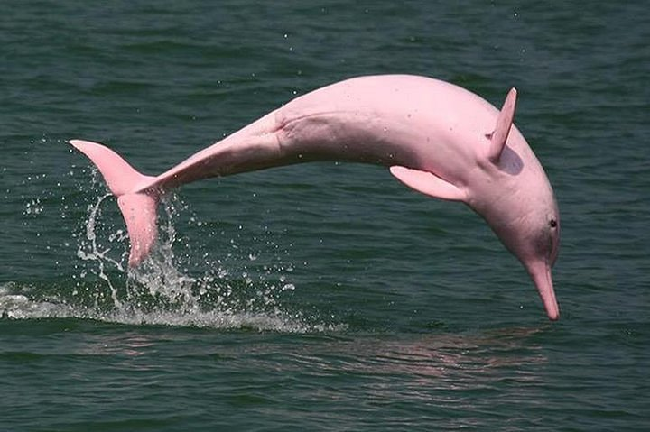
•TYPES OF SPECIES
IMAGE | SPECIES | GEOGRAPHICAL LOCATIONs
 | Delphinus delphis (Short beaked dolphin) | The Atlantic and Pacific Oceans.
 | Inia geoffresis (Amazon river dolphin) | The Amazon and Orinoco river basins.

Slide 4
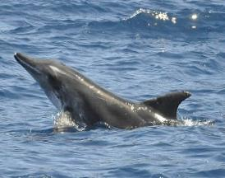
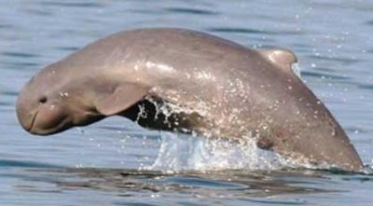
IMAGE | Species | Geographical locations
 | Steno bredanesis (Rough toothed dolphin) | The Indian, Pacific and Atlantic Ocean.
 | Orcaella heinsohni (Australian snubfin dolphin) | The Brisbane river.

Slide 5
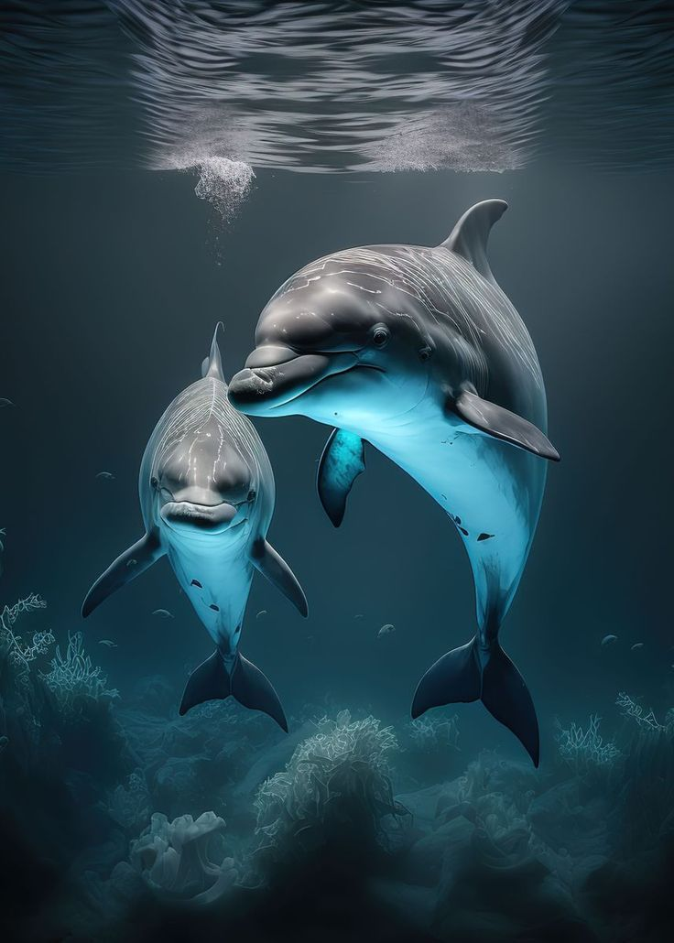
MORPHOLOGICAL
STRUCTURE
•BODY SHAPE : Torpedo-shaped bodies with non-flexible necks, tail fins, and bulbous heads.
• Color: Dark back, white underbelly.
•Teeth: 40–57 pairs of small, sharp teeth in each jaw.
•Dorsal fin: Hooked or curved.
•Brain: Thick brain stem, large cerebellum.
HABITAT
• They are fond of coastal waters.
• Generally, they prefer surface temperatures greater than 10 degrees Celsius.

Slide 6
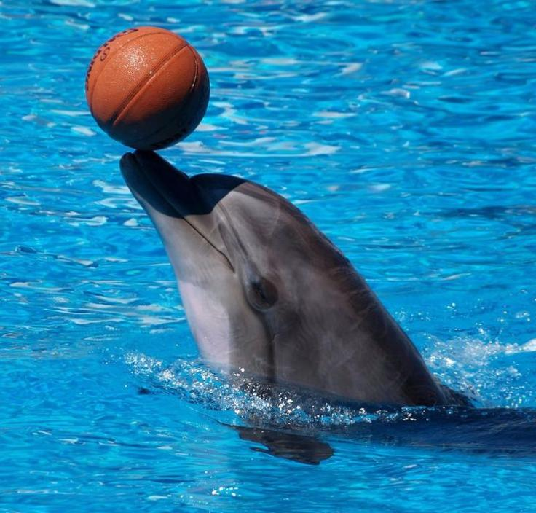
• GENERAL BEHAVIOUR:
Common dolphins (Delphinus delphis) are highly social and energetic animals.
They are fond of coastal waters.
Communicating: They communicate with each other using two voices. One voice is for navigation and location, and the other is for social communication
Traveling: They spend 57% of their daylight time traveling.
Taking turns: They take turns watching over those that are too active.

Slide 7
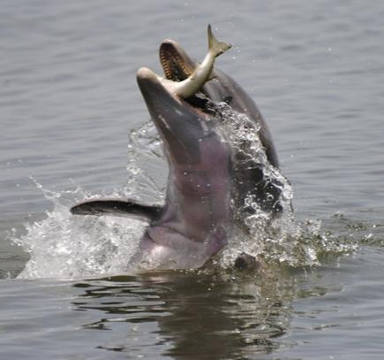
• Feeding behaviour :
Dolphins have teeth, but they don’t chew their food. Instead, they grab, bite, and swallow
They can eat up to 18–20 pounds of fish per day.
The short-beaked common dolphin, eat small fish, squid, and octopus.

Slide 8
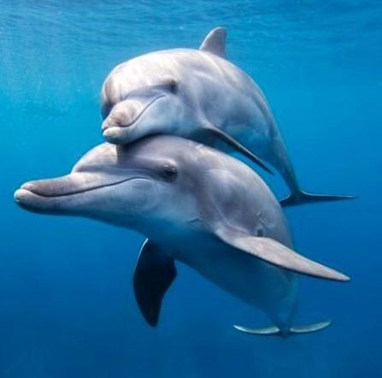
•Breeding habit :
Mating: Dolphins are polygamous, meaning they can have multiple mates.
Gestation period: The gestation period is 10 to 12 months.
Offspring: Females typically give birth to one calf every three to five years. The range number of offspring is 1 to 3.
Courtship: During courtship, dolphins engage in head-butting and tooth-scratching.

Slide 9
Acknowledgement
In the accomplishment of completion of my project on The short beaked dolphin . I would like to convey my special gratitude to our department of zoology Of Bangabasi Morning College. Your valuable guidance and suggestions helped me in various phases of the completion of this project. I will always be thankful to you in this regard. I am ensuring that this project was finished by me and not copied.
••••• THANK YOU •••••

